Slide 1
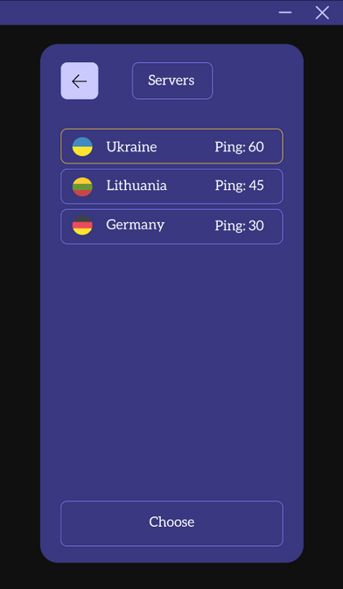

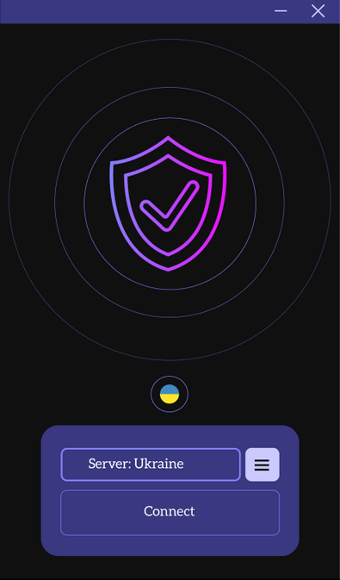
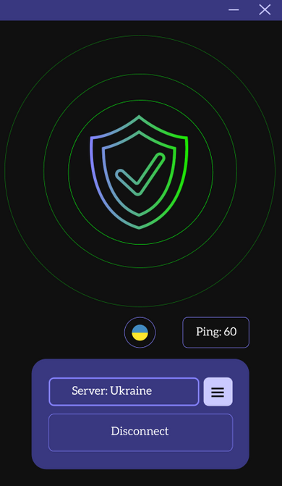
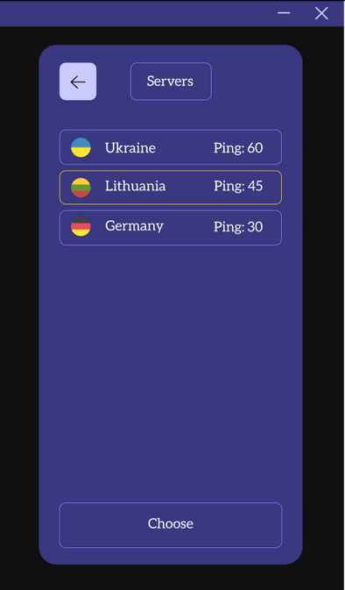

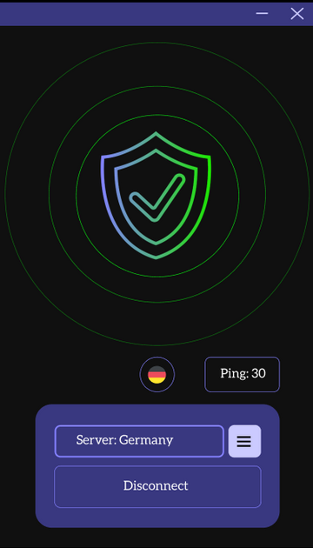
PROJECT PRESENTATION
VIRTUAL PRIVATE NETWORK (VPN) APP
Project was made by Sofiia Chekmenova, Yehor Poliarskyi, Oleksii Parshyn, Jaykumar Mathukiya, Stepan Kozlov

Slide 2


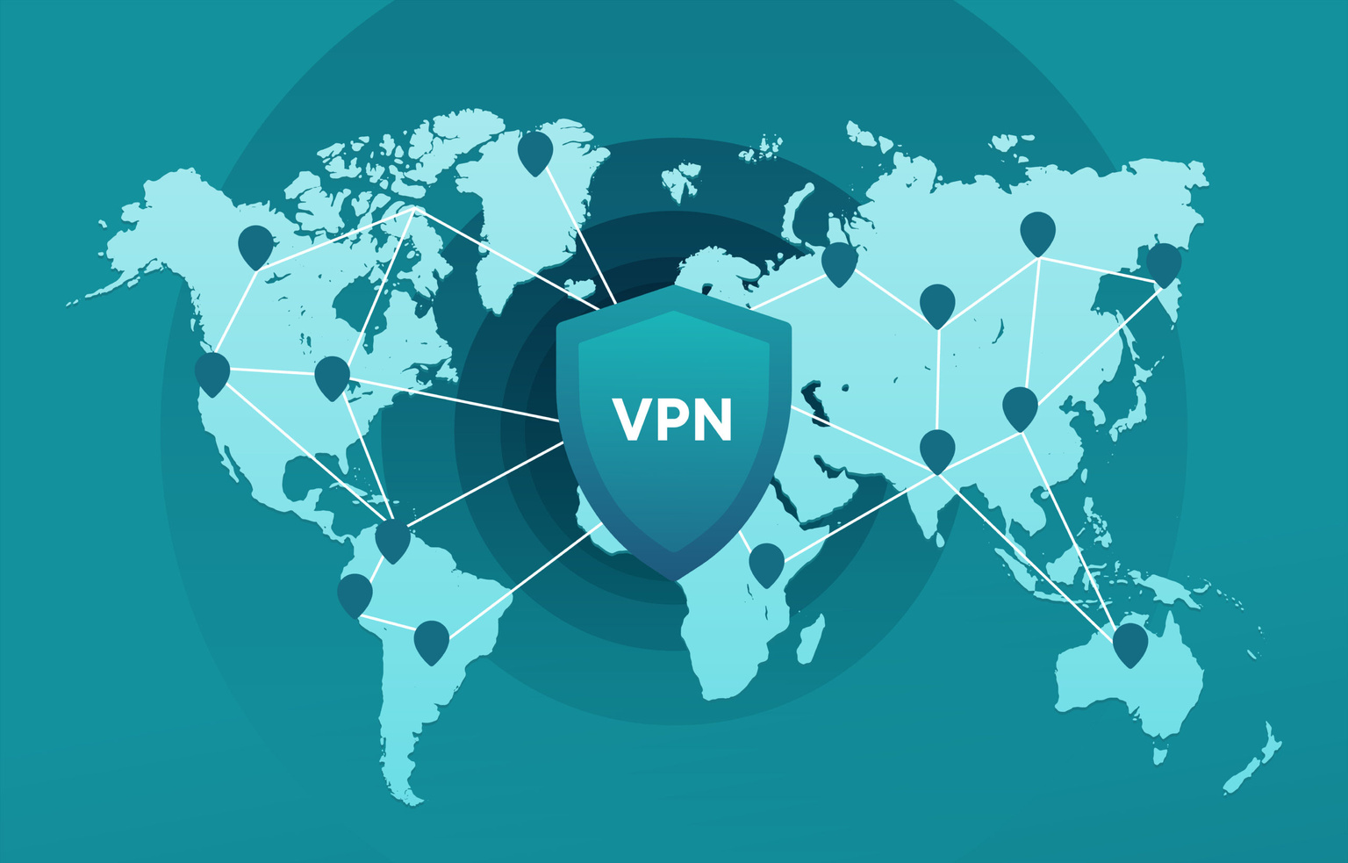
WHY WE CHOSE PROJECT TOPIC “VIRTUAL PRIVATE NEWORK (VPN)”?
We chose the project topic "Virtual Private Network" due to its relevance in addressing online privacy and security concerns, making it a compelling choice. Working on a VPN project allows us to collaborate with team members, share knowledge, and learn from each other's experiences, which can foster a sense of community and support.

Slide 3
LIST OF OUR GOALS
01.
02.
03.
04.
ANALYSIS
MAKE VPN DESIGN
MAKE SIMPLE PROTOTYPE
DO A REVIEW
Analyze the market for existing vpn's. Also analyze their demand, growth dynamics and market share, understand the basic needs of VPN users.
Create a simple and user-friendly initial design mockup that will possibly be used in a future project.
Do a review of the work done and how it might be interacted with in the future.
Create a working prototype that the user can directly test.

Slide 4
SOME PROBLEMS WHICH WE FACED
MARKET SATURATION
Analyzing the VPN market can be challenging due to the saturation of existing providers. Identifying a unique selling proposition (USP) for your VPN service is crucial.
MARKET RESEARCH DATA
Obtaining accurate and up-to-date data on market trends, user preferences, and competitors can be difficult, requiring comprehensive research.
SCALABILITY
Designing the VPN prototype to scale effectively as the user base grows without significant performance degradation.

Slide 5
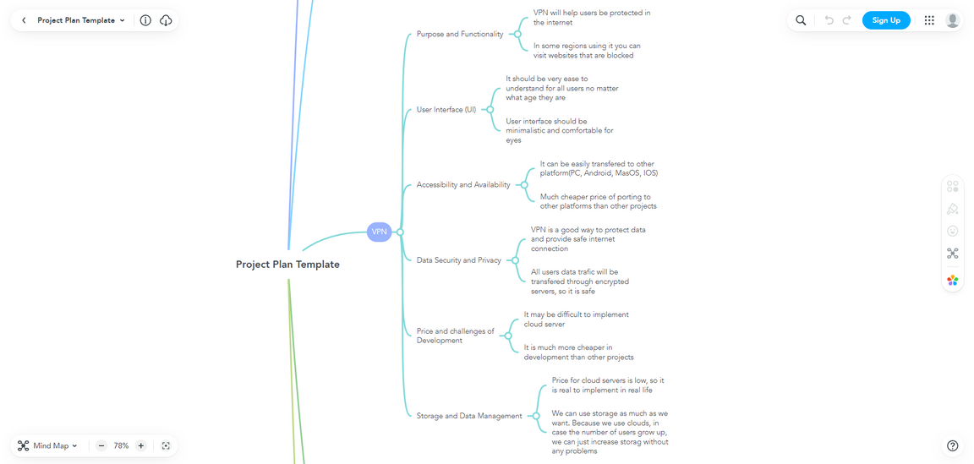
OUR MINDMAP
PURPOSE AND FUNCTIONALITY
ACCESSIBILITY AND AVAILABILITY
VPN will help users be protected in
the internet. In some regions using it you can
visit websites that are blocked.
It can be easily transfered to other
platform(PC, Android, MasOS, IOS). Much cheaper price of porting to
other platforms than other projects.
USER INTERFACE (UI)
It should be very ease to
understand for all users no matter
what age they are. User interface should be
minimalistic and comfortable for
eyes.
DATA SECURITY AND PRIVACY
VPN is a good way to protect data
and provide safe internet
connection. All users data trafic will be
transfered through encrypted
servers, so it is safe.
PRICE AND CHALLENGES OF Development
STORAGE AND DATA MANAGEMENT
It may be difficult to implement
cloud server. It is much more cheaper in
development than other projects.
Price for cloud servers is low, so it
is real to implement in real life. We can use storage as much as we want. Because we use clouds, in
case the number of users grow up,
we can just increase storag without
any problems.
LINK

Slide 6
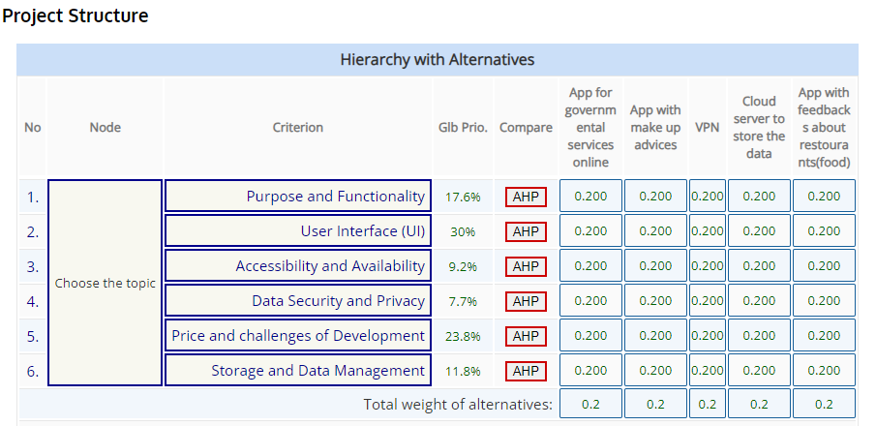


PAIRWISE COMPARISON AHP-OS
LINK

Slide 7
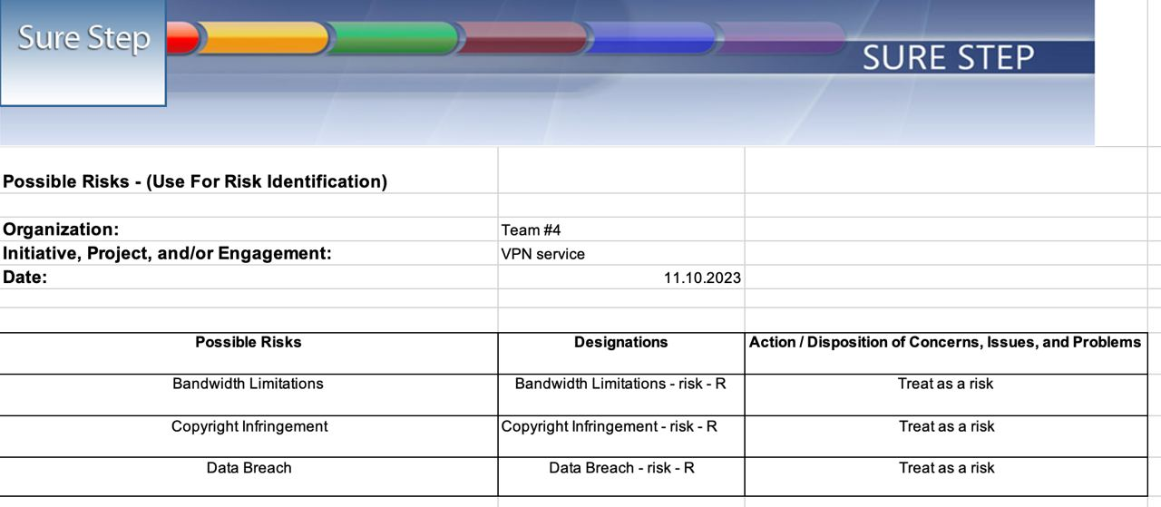
POSSIBLE RISKS

Slide 8
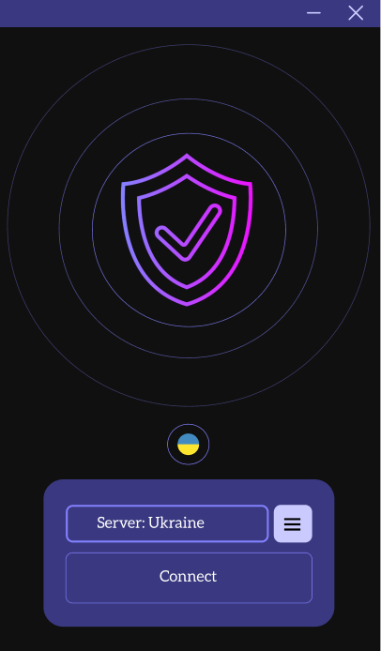
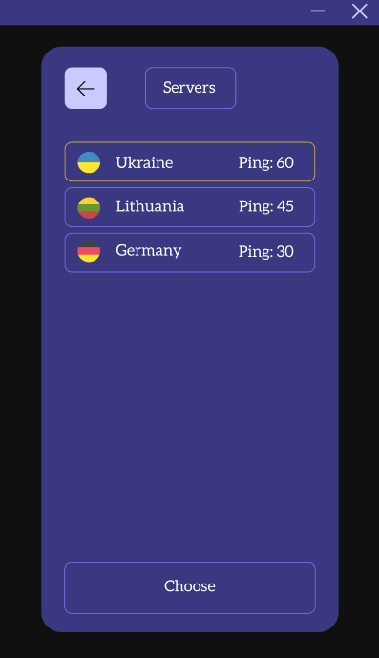

DESIGN AND PROTOTYPE
LINK

Slide 9
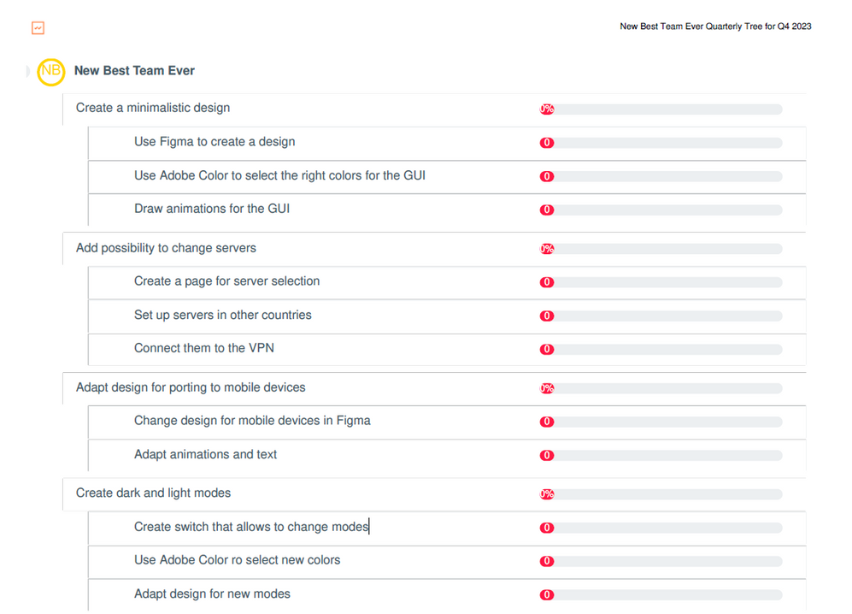
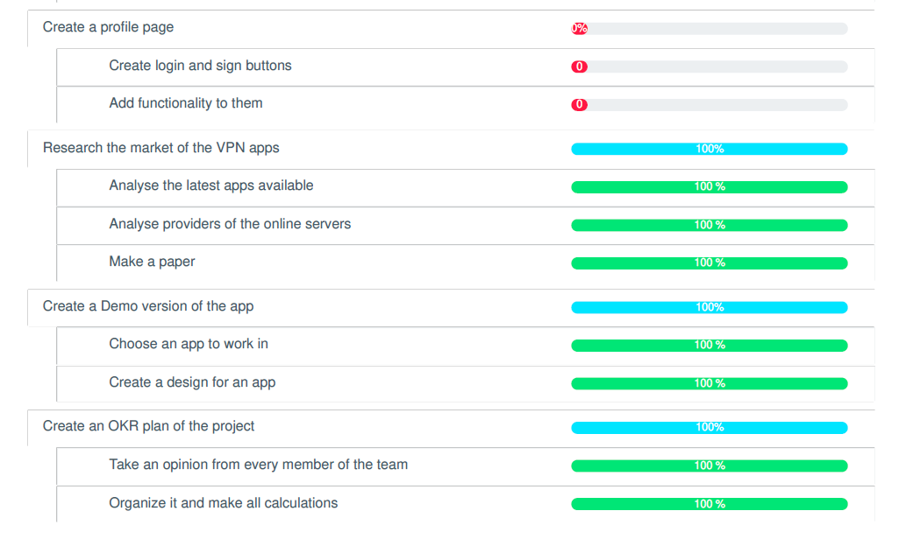
OUR WEEKDONE
LINK

Slide 10
QUESTIONS AND ANSWERS

Slide 11
THANK YOU FOR YOUR ATTENTION

